Slide 1
Re-engineering Cusip List Generation Process for improved Aladdin Data Extraction
Submitted by
Ankitesh Kushwaha
IIT2010082

Slide 2
Content
Introduction
Aladdin
Cusip
Cusip list
Types of Securities
GCL process

Slide 3
Introduction
BlackRock provide asset management to company
People invest in bonds, stocks and mutual funds

Slide 4
Aladdin
BlackRock’s central nervous system
Operating framework
Investment management platform
Centralized database for maintaining financial information

Slide 5
Cusip
Full form
Unique Identifier for a security
9-character alphanumeric code
Used in North America for security identification

Slide 6
Cusip List
List containing information about client securities
Generated at the end of day
Traded or non-traded Securities of client managed by BlackRock

Slide 7
Types of securities
Traded Securities
Externally held securities
Index securities

Slide 8
GCL Process
Perl Script running in batch mode
Runs at the end of day
Categorizes cusip specific to portfolio group from trade table into
Ever
Today
First
Update the trade table

Slide 9
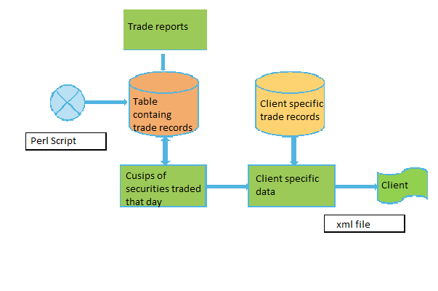

Slide 10
Re-engineering
Mould perl script into Beam BMS java based server
Real time updating of trade table
Comparatively faster
Robust and
Less resource extensive

Slide 11
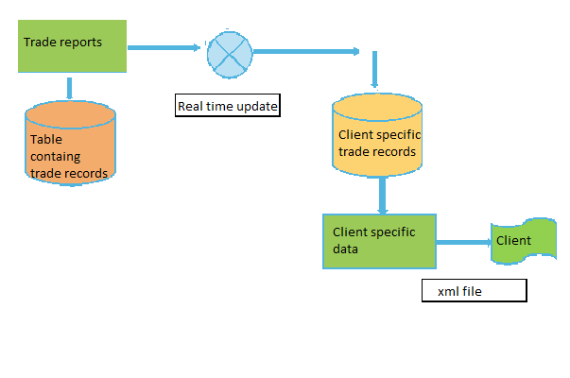

Slide 12
References
http://www.tutorialspoint.com/hibernate/
http://www.tutorialspoint.com/spring
http://en.wikipedia.org/wiki/Java_(programming_language)
http://en.wikipedia.org/wiki/XML

